Slide 1
Donor Application Screening

Slide 2
Introduction
Donorchoose.org is an organisation which funds school level projects.
Teachers from different schools request for the material they require for the students.
Each year they receive thousands of applications for which they require lot of manpower and time to screen this applications.
So, to make it more easier they want to automate this application screening process.

Slide 3
Objective
The goal here is to predict whether the proposal would be approved or not based on the description provided in application.
Use efficient algorithms for training the model for predicting accurately.

Slide 4
Dataset
Dataset we worked on is taken from kaggle.
(https://www.kaggle.com/c/donorschoose-application-screening/data)
The size of zip file of this dataset is 203.9MB. It contains following files:
Train.csv: It contains the data of 182080 proposals and has 16 features.
Test.csv: test data for 78035 proposals and has 15 features.
Resource.csv: data of resources requested, their quantity and price. It has 1541272 entries and have 4 features.

Slide 5
Technologies Used
Anaconda Navigator for jupyter notebook
Python as Programming Language
Tableau for better visualization
Libraries used: scipy, numpy, pandas, nltk, sklearn, matplotlib, plotly, seaborn

Slide 6
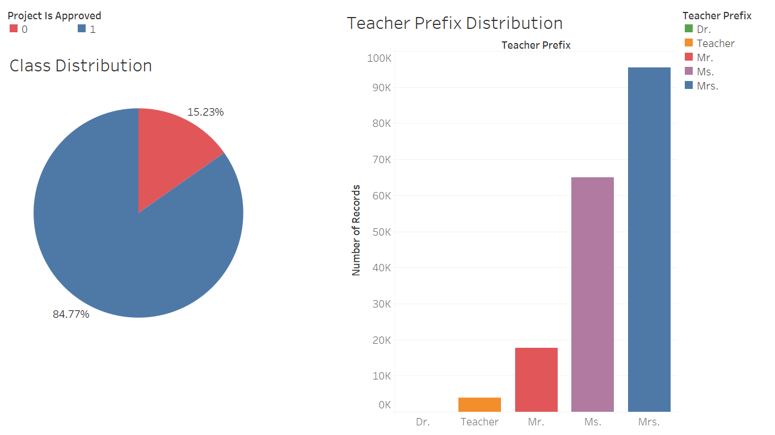
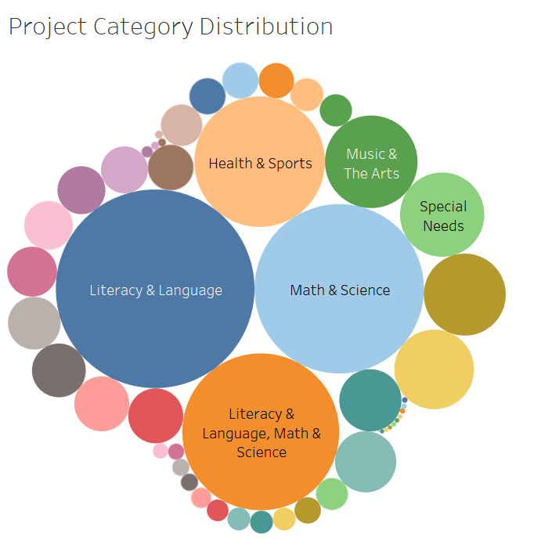
Visualization

Slide 7
Data Preprocessing
We merged train.csv and resource.csv based on id.
Based on visualisation and data exploration, we did feature extraction. The features which we selected to use were text based.
Replacing null values: We checked for the null values in the data set and replaced those null values with some string.
Applied Tfidf vectorization on the text features of data set for removing special characters, stop words, stemming and for generating tokens.

Slide 8
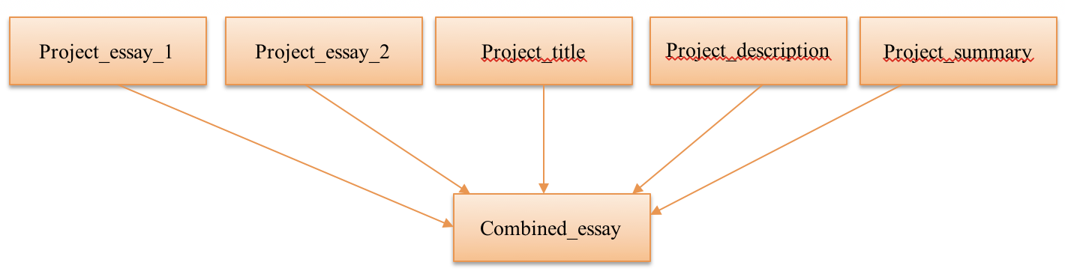
Data Preprocessing
Feature extraction:
Created Text feature from using features
Created total price and total quantity feature from resource.csv

Slide 9
Data Preprocessing
Conversion of Categorical Features into Numeric Vectors
school_state
project_subject_categories
project_subject_subcategories
teacher_prefix
Feature Removal
id
project_title
project_essay_3
project_essay_4
teacher_number_of_previously_posted_projects
Categorical Features

Slide 10
Algorithms
Logistic regression
SVM
K-nearest neighbors
Naive bayes
Xgboost
Lightgbm
Random forest
Decision tree/Gradient Boosting based
Adaboost
Xgboost
Lightgbm

Slide 11
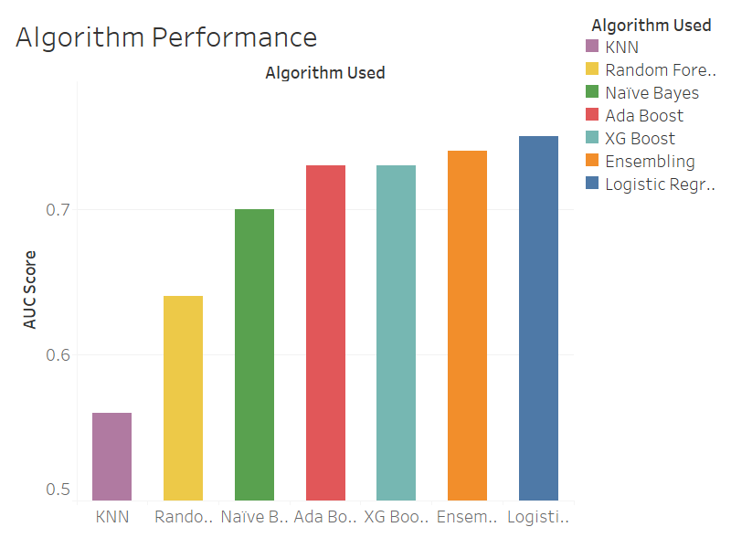

Slide 12
Algorithms- worked for us
Based on the accuracy, selected the following algorithms for final model.
Logistic regression
Naive bayes
Xgboost
Random forest

Slide 13
Evaluation and Methodology
We followed n-fold cross validation for value of n=5. Considered average as final validation score.
We performed cross validation on all experimented algorithm and then selected the models which gave best accuracy.
Ensemble learning : We used the combination of the algorithms which gave us best results by ensembling it.

Slide 14
Things that worked /Things that didn’t worked
Things that worked:
Referred kaggle’s beginner tutorial.
All worked on preprocessing to make it faster and easier.
Experimenting different models to get more accuracy for getting optimized results.
Things that didn’t work well:
Some algorithms were taking very long time to implement. Like SVM took a lot of time to implement.

Slide 15
Conclusion
Spending quality of time in preprocessing of data is necessary to get optimized results.
Feature Engineering can make algorithms to work better.
Simple algorithms works better than complex on some datasets.

Slide 16
References
https://towardsdatascience.com/machine-learning-nlp-text-classification-using-scikit-learn-python-and-nltk-c52b92a7c73a
https://www.youtube.com/watch?v=ZiKMIuYidY0&t=4931s
https://www.kaggle.com/c/donorschoose-application-screening
http://scikit-learn.org/stable/modules/generated/sklearn.feature_extraction.text.TfidfVectorizer.html

